Slide 1
B.TECH CSE with Specialization in Big Data
Big Data Overview
Data Growth Explosion
Notes:
Notes to the Facilitator:
Introduce the module to the participants. Tell them that you will talk about Data Growth Explosion in this module.
Notes to the Participant:
You will be going through the Big Data Overview in this module. You will learn about Data Growth Explosion.

Slide 2

Module Learning Objectives
Module 1: Data Growth Explosion
At the end of this module, you will be able to:
List the sources of data
Identify multiple sectors that generate huge volumes of data
Identify the sources of data
Enumerate the different types of data and examples
Define data explosion
List and explain the challenges of Data Explosion
Notes:
Notes to the Facilitator:
Reiterate the module objectives.
Tell the participants that at the end of the module, they will be able to:
List the sources of data.
Identify multiple sectors that generate huge volumes of data.
Identify the formats of data that is generated.
Enumerate the different types of data with examples.
Define ‘Data Explosion’.
List and explain the challenges of Data Explosion.
Notes to the Participant:
At the end of the module, you will be able to:
List the sources of data.
Identify multiple sectors that generate huge volumes of data.
Identify the formats of data that is generated.
Enumerate the different types of data with examples.
Define data explosion.
List and explain the challenges of Data Explosion.

Slide 3
Module Topics
Module 1: Data Growth Explosion
Let us take a quick look at the topics we will cover in this module:
Sources of Data
Data Deluge Problem
Notes:
Notes to the Facilitator:
Tell the participants that they will be discussing two topics in this module.
List out the topics for them.
Notes to the Participant:
Look at the topics you will be covering in this module.

Slide 4

1. Data is everywhere
Module 1: Data Growth Explosion
Notes:
Notes to the Facilitator:
Start by emphasizing the students that everything around us is data. Any piece of information about anything around us is data.
Notes to the Participant:
What is data?
Any unorganized, raw fact that needs to be processed is called ‘Data’. When processed, it becomes ‘Information’.
There is no single source of data. Any raw piece of information about or related to all that is around us is data.
With the advent of PC explosion, the availability of data has become abundant. Every individual is producing and consuming data at all points in time. Details of individuals, health information, industrial operations, inputs, outputs, machine status, every single thing around us can be represented as data.
Sources of data can be infinite and the size of individual data files that is generated every day is also arbitrary.

Slide 5


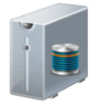





1.1 So… can we have some examples?
Module 1: Data Growth Explosion
………
………
Notes:
Notes to the Facilitator:
Discuss with the participants on the data generated by different sectors.
Notes to the Participant:
As mentioned in the previous section, starting from individuals to small companies to bigger enterprises, irrespective of the size, every entity around us generates data in some form or the other. Some of the sectors that generate huge volumes of data on a daily basis include banking, healthcare providers, manufacturing, retail, education, transportation, communication and media, oil and gas industries, research agencies, and many more.
The type, kind and size of data these sectors generate also vary. Common examples of the data types include text files, video, audio, images, numbers and various other types of files. The kinds of data generated also vary, depending on the sector that generates them. Most common examples include data on transactions, data on IT infrastructure, data generated from application development, manufactured products, patients’ information, share-market growth, so on and so forth.
From an overall perspective, the ability to store, process, interpret, consume and analyze data has improved over the time.

Slide 6

1.2 Activity
Module 1: Data Growth Explosion
Notes:
Notes to the Facilitator:
Ask the students: how much of information do they get from a physical or online newspaper.
Notes to the Participant:
On a daily basis, we read physical or online newspapers (do not include e-newspapers, which are the scanned copies of physical newspapers). Form different groups and discuss the amount and kinds of data that you get through a newspaper. Observe and tell, how many times a single piece of news gets refreshed in case of online newspapers. Also, compare the amount of news that you can get from a physical newspaper to that of an online newspaper.
Also, discuss the different industries that serve as a source for this data.

Slide 7
2. Different Sources of Data
Module 1: Data Growth Explosion
Machine
Data
Social
Data
Transactional
Data
Broadcastings
Electronic Files
Notes:
Notes to the Facilitator:
Explain the common sources of data.
Notes to the Participant:
Most common sources of data include the following:
Social data: This is the data generated and shared by humans over the internet. Social media data is the most common example of this kind. Through this data, qualitative and quantitative aspects will be measured, where the latter one is easier to measure. Quantitative measures take into account the number of observations which are grouped by geographical or temporal characteristics. Qualitative measures require that the algorithms need to be accurate in order to extract the meaning of unstructured data available in the natural language. Data generated from social media provide many valuable insights into consumer behaviour and sentiment analysis can also be performed using the data. This can very well be integrated with CRM for analytics. The potential of this can be understood by the following statistics: about 230 million tweets posted on Twitter per day, about 900 Instagram photos are uploaded every second, about 2.7 billion Likes and comments added to Facebook every day, and 60 hours of video uploaded to YouTube every minute and about 73,411 videos are viewed every second.
Machine data: This data comprises of information generated from the industrial pieces of equipments, real-time data generated from the sensors that track the parts and monitor machinery (Internet of Things) and even weblogs that track user’s behaviour online. Data generated by sensors/meters are real-time data, the number of observations and frequency may vary. It may have dependencies on others for some event to happen. Sometimes it may depend on manual manipulations. The capacity of the sensor in taking accurate measurements in the expected format plays a major role in determining the quality of this kind of data. The Large Hadron Collider (LHC) located at Arcplan client CERN, the largest particle physics research centre in the world, generates 40 TB of data every second during experiments.
Transactional data: Day-to-day business activities generate these data. This can either be structured or unstructured. When stored in a structured database, data processing becomes difficult, since large volumes of data are generated frequently at a faster pace. For example, thousands of records of sales data gets generated in a retail business chain in a second. Most of the time, these data are not generated in formats that can be directly stored in a relational database. For example, data produced from an electronic invoice generated during sales need some processing to store it under proper structures of a relational database. This needs a lot of time, also data is generated at a fast pace and data processing and usage needs different strategies. Quality of information produced from business transactions is closely related to the capacity to get representative observations and the ability to process them. Large retailers and even B2B companies can generate multitudes of data on a regular basis, considering that their transactions consist of one or many items, product IDs, prices, payment information, manufacturer and distributor data, and much more. E-commerce giants like Amazon.com and restaurant chains like “Domino’s” are generating petabytes of transactional data.
Electronic Files: These are unstructured documents stored or published as electronic files, like web pages, video, audio, PDF, etc. These files may either be produced statically or dynamically. Content in these files might be difficult to extract, and techniques like text mining or pattern recognition are needed to extract information from these files. Quality depends on the capacity to extract and interpret the representative information from these documents.
Broadcastings: Primarily contains video and audio data produced real-time. Retrieving statistical information from this kind of data is too complex and requires high-performance computational devices. Once converted from analogue to digital, complexities arise while processing this kind of data.

Slide 8
3. Types of Data
Module 1: Data Growth Explosion
Structured
DATA
Unstructured
Semi-structured
Notes:
Notes to the Facilitator:
Tell the participants that there are three categories of data.
Inform them that you will explain all the three categories to them in detail.
Exemplify each type of data.
Notes to the Participant:
Data is broadly classified into three categories:
Structured data: Structured data is the simple and highly organized type of data. Data is written in a defined format that is easy for machines to understand and is easily searchable even by basic algorithms. Structured data usually resides in relational databases (RDBMS) and is searchable using queries and algorithms, using data type and field names.
The Common examples of structured data include spreadsheets and data from machine sensors. The Common relational database applications with the structured data include airline reservation systems, inventory control, sales transactions, and ATM activity.
Unstructured data: The Comprised of data that is not easily searchable, and the formats include audio, video, social media postings, etc. There is an internal structure to unstructured data, but no pre-defined data models or schema. Unstructured data may be human- or machine-generated. Common examples of unstructured data include text files, emails, social media, website, satellite imagery, scientific data, sensor data, etc.
Semi-structured data: The Semi-structured data contain semantic tags but they do not conform to the structure associated with typical relational databases and can have different attributes. They fall in between structured and unstructured data, where some of the aspects are structured and some are not.
More about the types of data will be explained in the later section.

Slide 9

3.1 Group Discussion
Module 1: Data Growth Explosion
Notes:
Notes to the Facilitator:
Form different groups of students and make them discuss, the kinds of data generated by a typical IT organization. Tell them about the following data:
Employee data
Application data
IT Infrastructure-related data
Physical infrastructure related data (like office space, amenities available, etc.)
Asset maintenance data
Customer-related data
Financial data
Notes to the Participant:
Discuss the different types of data generated by a typical IT organization and classify, which of them will be in a processed form and which of them in the unprocessed form. Identify which of them is variable over time, classify them based on criticality also.

Slide 10
What did you grasp?
Module 1: Data Growth Explosion
Which of the following data is useful in knowing consumer behavior?
Transaction data
Social data
Machine data
None of the above
Social media post is an example for structured data.
True
False
Notes:
Notes to the Facilitator:
Tell the participants that they will now attempt a knowledge check question.
Inform them that they will get a single attempt.
Answer
1. B. Social data
2. B. False

Slide 11
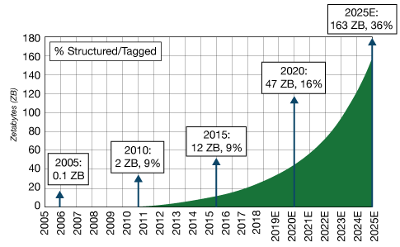
4. What is data explosion?
Module 1: Data Growth Explosion
The rapid or exponential increase in the amount data that is generated and stored in computing systems, that reaches a level where data management becomes difficult, is called ‘data explosion’.
The term ‘information explosion’ and ‘data explosion’ are replaceable terms.
Data is stored for a long time, replicated many times and shared widely.
As the amount of data continues to grow, complexities and diversities associated with data and its management also increase.
Source: Kleiner Perkins
Notes:
Notes to the Facilitator:
Explain to the participants, how the amount of data has grown over time. Explain about traditional computing or storage systems and how they become obsolete with the growing volumes of data.
Notes to the Participant:
The world is now used to saving anything and everything in the electronic space. Computing power, RAM speeds and hard disk sizes have increased to a level that has changed our outlook towards data and its storage. Can you imagine having a 256 or 512MB RAM in your PC now?
If we understand the concept of byte, we can imagine how data growth has increased over time and how storage systems handle it. We all are aware that 1 byte is equivalent to 8 bits and these 8 bits represent a character or expression. A document with millions of bytes will contain millions of characters, expressions, spaces, etc. Likewise, a megabyte (MB) is a million bytes of data, a gigabyte (GB) is a billion bytes of data and a terabyte (TB) is a trillion bytes of data. We all use these terms while dealing with data and storage, on our day-to-day activities.
But it doesn’t end here. Next comes the petabyte, which is quadrillion bytes or a million gigabyte. The ones after that are Exabyte, Zettabyte, and Yottabyte. A Yottabyte is essentially a trillion terabytes of data. There are even higher numbers, but we’ll stop here at this point.
According to a report by the International Data Corporation, IDC, in 2009 that the total amount of data in the World was 800EB. It is expected to rise to 44ZB by the end of 2020, i.e., 44 trillion gigabytes. The second statement they made was that 11 ZB of this data will be stored in the cloud. The primary reason for data explosion is that individuals and enterprises are always connected to the internet, generating and sharing loads of data.

Slide 12
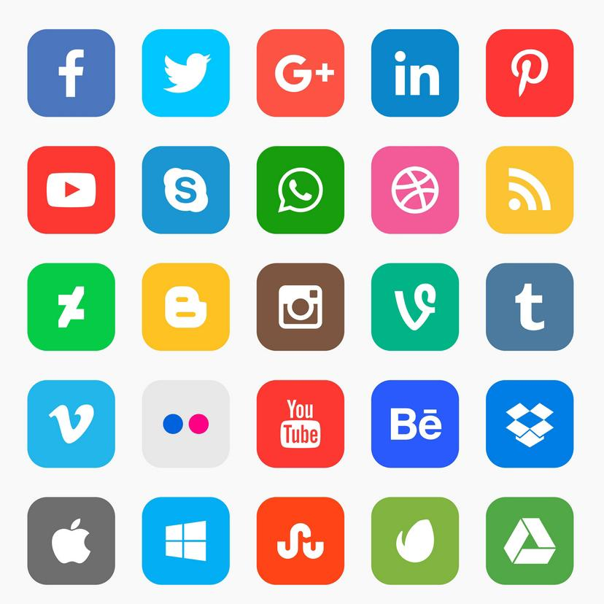

4.1 What has led to data explosion?
Module 1: Data Growth Explosion
Key drivers of data explosion
Increase in storage capacities
Increase in data processing abilities
Emerging data formats and data availability
Notes:
Notes to the Facilitator:
Explain the participants about the key drivers that enable the exponential growth of data.
Notes to the Participant:
Data has been there at all points in time in some form or the other. The ability to capture data, store and process it is the critical element. Digitalisation has played a huge role in the proliferation of data. Computing devices were confined to only a set of industries earlier. With the advent of PC explosion, server-client models came into play, this leads to the digitalisation of almost all industries. The amount of digitally available data also started growing around this period.
Analysts predict an exponential growth in data toward 2020 and beyond. Data growth for the period 2010 to 2020 was predicted to be 50-fold. Overall, there is a 10X faster growth in the combination of human and machine-generated data in comparison to traditional business data. Out of these, machine-generated data alone, is increasing at a rapid 50X phase.
The key drivers of data growth include the following:
Increase in storage capacities.
Increase in data processing capabilities by modern computing devices.
Data generated and made available by different sectors.

Slide 13
4.2 Increase in Storage Capacities
Module 1: Data Growth Explosion
Enterprises are procuring high-performance computing infrastructures in data centers.
Virtualized data centers, migration of assets to cloud.
Organizations making use of object storage for structured data
Growth triggered by Artificial Intelligence (AI), analytics and Internet of Things (IoT).
Notes:
Notes to the Facilitator:
Explain to the participants how companies or large enterprises are paying attention to capture, store and manage data. Tell them that data is becoming an important driver for the growth of businesses in new arenas. To unleash the potential of data companies are investing in storing and managing the huge volumes of data that is generated on a day-to-day basis.
Notes to the Participant:
Data analytics as a business has triggered the explosion of data. Businesses are now paying attention to collect, manage and store data.
Data-intensive businesses demand ever-greater storage capacities, and these businesses will also depend on tagged data to function in an effective way. Storing vast amounts of data will not make sense if it could not be retrieved when there’s a need and most importantly if there’s little knowledge of the data that is stored.
Structured/tagged data are a type of metadata and is required for analysis. Without metadata, unstructured data becomes unsearchable and metadata is important for navigation, analysis and usage.
Companies are now harnessing the power of Artificial intelligence and IoT big time. IoT is applied in smart homes, wearables, smart cities, smart meters, industrial machines and sensors, smart retail applications, healthcare, etc. These sensors produce data continuously. For example, IoT for patient monitoring in critical care units is receiving a lot of attention, as the data helps the attending physician in monitoring the patient’s vitals efficiently. As hospitals start leveraging the potential of these devices and sensors, they are also investing in storing the data thus obtained. The storage system has to be equipped with better security and privacy protection systems.
The more IoT and AI grows, more is the data generation and more is the demand for storage systems and analysis and processing technologies. Big data also fuels the growth of AI, since huge amounts of data is required for training the systems to impart the intelligence into them.
Enterprises are now investing in storage systems, which is needed for management of data. A good example of this is in the management of video assets, media and entertainment, surveillance and security, etc.
When it comes to data storage, the concept of tiered storage been in existence for 20 years until the early 2000s. When disk storage prices were dropped, tiered storage was considered as an unnecessary expense. In 1995, storage costs for a GB of data were around $1000. Within five years, the cost per GB came down to less than 10 cents per GB, and today it costs around 3 cents per GB, which has made companies increase their storage capacities. Though the cost of storage devices have come down, the other costs associated with the storage needs to be looked at.

Slide 14
4.3 Data Processing Abilities
Module 1: Data Growth Explosion
Supply and availability of data is one of the major reasons for the development of high-performance data processing devices.
Development of high-efficiency computing devices to process huge volumes of data in seconds.
Input 1
Output 1
Input 2
Output 2
DATA
PROCESSING
Input 3
Output 3
Notes:
Notes to the Facilitator:
Tell the participants that you will now explain how data can be processed and the abilities involved in the same.
Notes to the Participant:
Extremely large volumes of data have not been traditionally captured by computing devices, the primary factor being the high cost and infrastructure requirements needed for this purpose. However, the cost has been lowered to great extent because of the advent of multiple factors and new technologies. The technology barrier in data processing has also been eliminated by these new technologies. This effective data processing has enabled even smaller organizations to unleash the potential contained in different data sources. For example, frameworks like Hadoop can handle complex unstructured data which traditional relational databases struggle to handle.

Slide 15
4.4 Emerging Data Formats and Data Availability
Module 1: Data Growth Explosion
Data that is churned out on a daily basis has increased by leaps and bounds.
There’s a prediction by market intelligence firm IDC that around 160ZB (zetta bytes) of data will be created by 2025.
Consumers and businesses who create, share and access data between any device and cloud will also grow well beyond the previous expectations.
Notes:
Notes to the Facilitator:
Explain to the students that the new formats of data are generated as time progresses and with the advent of internet-scale companies and social media, data availability and data that is shared has grown by leaps and bounds. Availability of data is also adding fuel to the growth of data. This has also been one of the major drivers for businesses who are into research and analytics.
Notes to the Participant:
According to an analysis, the internet witnesses about 55618 GB of traffic in a second and about 66,365 queries are placed on Google search each second and a mind-blowing number of about 2.7 million emails are sent every second.
The meteoric rise of data will also provide a lot of opportunities for the enterprises to gain an advantage in the market. Organizations are also investing in collection, utilization and management of data. IDC also predicts that the amount of data that will be subject to data analysis will also grow by a factor of 0.5 to 5.2ZB by 2025.
Further to data availability, newer formats of data are constantly emerging which fuel data explosion. In addition to the common data formats like text, video, audio, html, xml, pdf, etc., newer formats are emerging, examples are: tracking data, monitoring the movement of people and objects (including GPS/geolocation data, traffic and other transport sensor data, CCTV etc.), satellite and aerial imagery (eg. Google Earth, Landsat, infrared, radar mapping etc.).
As more and more of these formats emerge, the more will be the demand to extract the value out of them. New technologies will be identified to process and analyze them, which is a great driver for the growth of big data as an industry.

Slide 16
What did you grasp?
Module 1: Data Growth Explosion
Give an example for a framework that can process complex, unstructured data.
Notes:
Notes to the Facilitator:
Tell the participants that they will now attempt a knowledge check question.
Answer
1. Answer: Hadoop (There can be multiple correct answers, this example is given in the text.)

Slide 17
4.5 Problems of Data Explosion
Module 1: Data Growth Explosion
Storage, data movement and management complexity
Data center power, cooling, and floor space limitations
System management and growing database complexities
Availability of security systems to protect data
Lack of support for heterogeneous environment
Significant shortage of skills to integrate and manage the data
Notes:
Notes to the Facilitator:
List down the various challenges associated with data proliferation. Each of these will be explained in upcoming sections.
Notes to the Participant:
For industries like finance, healthcare or the ones with multiple industry verticals, data generated becomes complex and challenging hence these industries need much better infrastructure to handle and process data. Some of the challenges associated with the processing and management of growing amounts of data are listed above.

Slide 18
4.5.1 Storage, data movement and management complexity
Module 1: Data Growth Explosion
1
Conversion of data formats and replication of data
3
Cost associated with storage
Challenges associated with storage and maintenance
2
Notes:
Notes to the Facilitator:
Explain the students about the challenges associated with the storage, the movement of data, the cost and the complexities associated with the data management.
Notes to the Participant:
No data is unimportant. In the internet-scale companies, data deletion never happens. Multiple formats of data exist and the cost associated with standardization of data and conversion of formats have gone high. Creating and operating a local area network requires much storage. Every system that is required to run a network, has storage space requirements for its operating system, configurations and security.
To make the data highly available, the associated cost also increases. Though the cost of storage devices have come down, associated costs and management complexities are very high.
Today’s data is consumer-driven, and high availability is still a challenge. The cost and complexities associated with the data replication are also very high. To maintain high availability and replicate data, multiple copies of data have to be maintained, hence the multiplied cost.

Slide 19
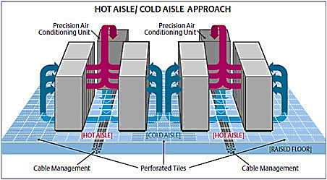
4.5.2 Data center power, cooling, and floor space limitations
Module 1: Data Growth Explosion
Growth of computing capacity, means growth of more data centers and their availability and maintainability
Real estate power and manpower cost have exponentially increased in the last few decades.
Indirect cost of computing capacities have added a huge burden on organizations’ ability to handle data explosion
HOT AISLE/ COLD AISLE APPROACH
Precision Air Conditioning Unit
Precision Air Conditioning Unit
Hot AISLE
Cold AISLE
Hot AISLE
Raised Floor
Cable Management
Perforated Tiles
Cable Management
Notes:
Notes to the Facilitator:
Explain the concept of data centres to students. Explain to them that as the computational capacity increases, the need for highly available data centres also increases. Explain them the components of a typical data centre and the total cost of ownership associated with data centres like construction cost, floor space, maintenance, HVAC power cost, rack cost, storage and networking equipment.
Notes to the Participant:
As the need for high-performance computing systems increase, the need for highly available data centres also increases. Know the various components of data centres and the cost associated with construction and maintenance of data centres.

Slide 20

4.5.3 System management and growing database complexities
Module 1: Data Growth Explosion
Complex relations among data
Computing capacity/availability to process complex data
Inability of existing systems to handle huge volumes of data
Analysis of data and deriving useful patterns out of it is a challenge
Clustering of databases for high-end enterprise applications is a challenge
Algorithms lack the ability to handle complex clusters without supervision.
Notes:
Notes to the Facilitator:
Explain the students the need for high-performance computing systems to handle complex data like geospatial information, genome analysis data and data on drug discovery.
Notes to the Participant:
With the increase in the number of internet-scale companies, the amount of data that is churned out and to be processed has increased to a great extent and the need for high-performance systems to analyze and process data has also increased.
In most of the applications, due to the huge volumes of data available, identifying the suitable data for analysis and managing the uncertain data.
There exists a complex relationship among the data. Think of Facebook’s friend recommendation engine. A number of factors have to be considered by Facebook before you get a suggestion. Location, education, job, ethnicity, common interests and the common groups where you both are part of. And this analysis has to be done in seconds before the suggestion is shown. Do you think, traditional data processing systems have the capacity to handle this complex data?
A database cluster is one which is a collection of commodity components to maintain scalability and availability. With growing amounts of data, the need for developing complex database clusters also increases. For storing and processing these complex data, flexible databases like NoSQL were developed. Facebook’s algorithms are designed to handle the complex relations among data. No wonder, a friend of your friend’s friend is shown as a friendly suggestion to you.
Another example you can think of is Google Instant. Once you type a single alphabet, Google will show you relevant suggestions based on your location, and browsing history.

Slide 21

4.5.4 Availability of security systems to protect data
Module 1: Data Growth Explosion
Issues with the encryption of data
Need of Access Control Lists (ACL)
Need of secure methods to transmit large blocks of data
Need to ensure confidentiality, integrity, and availability
Notes:
Notes to the Facilitator:
Explain the students about the importance of data security and how the data security becomes complex with growing amounts of data. Explain the various measures to be taken to secure the data.
Notes to the Participant:
Data security can be a daunting task with growing amounts of data. Data owners must understand the importance of maintaining Access Control Lists (ACL) for their data. They also need to make sure that users who are not given full access to data, work within their access rights.
Many of the regulations need data to be encrypted before it is stored, to protect from the breach. Encryption of large volumes of data is not an easy task. Encryption keys need to be changed periodically if data is accessed on a daily basis for business needs. Resilient tools need to be used to make sure that the data inaccurate and unmodified by unauthorized users.
Security methods need to be followed while transmitting large blocks of data. Secured availability of data will be important for the healthcare industry, as Electronic Medical Records (EMR) should be stored securely and access of patient data by unauthorized personnel must be prevented.
As the amount of data grows at a rapid pace, maintaining all these security standards will become over-complicated.

Slide 22
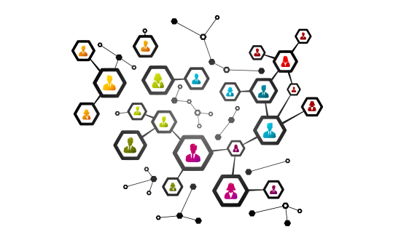
4.5.5 Lack of support for heterogeneous environment and accelerators
Module 1: Data Growth Explosion
Multiple formats of data that is generated
Heterogeneous nature of data created, analyzed and processed.
Multiple platforms and databases maintained by enterprises
Ensuring data availability in heterogeneous environments is complex and time consuming.
Lack of support systems in organizations
Notes:
Notes to the Facilitator:
Explain the students about the heterogeneous nature of the data that is generated in the organizations. Tell them that the companies maintain multiple platforms and databases and ensuring data availability in these heterogeneous environments is time-consuming and a complex task.
Notes to the Participant:
As discussed in earlier sections, the data comes from different sources and in different formats. Traditional computing systems are not equipped to handle this heterogeneous nature of data. To process and analyze this heterogeneous data, complex systems have to be developed. In many of the organizations, poor support system exists for managing this heterogeneity.
Though the relational databases can capture and store huge quantities of data, data warehouses built from traditional databases create almost insurmountable problems during the analysis of massive volumes of data generated by an entire business. A data warehouse built on relational technology is usually several times the size of the databases, it draws its information from. This results in the source data to be imported, and all the indices and aggregated views required for analysis need to be stored.

Slide 23
4.5.6 Significant shortage of skills to integrate and manage the data
Module 1: Data Growth Explosion
Increase in data complexity and availability
Lack of skilled personnel who deal with these complex data types, formats and data processing systems
Deficiencies in understanding the complex relationships that exist among data.
Notes:
Notes to the Facilitator:
Explain the various skills required to analyze and process the complex data, working with the high-efficiency computing and data processing systems.
Notes to the Participant:
As the amount of data grows, the need for the skilled workforce who can understand and work with this data also increases. Personnel who are trained in traditional data processing systems face significant issues when deployed to handle the complexities of data. This results in a lag in the amount of data that needs to be processed and impacts businesses seriously. Training of personnel in high performance/efficiency computing systems, storage technologies and data processing systems will help alleviate this challenge.

Slide 24
4.6 Group Discussion
Module 1: Data Growth Explosion
Notes:
Notes to the Facilitator:
Form multiple groups of students and make them discuss the issues that arise due to the proliferation of the data in short time.
Notes to the Participant:
Though the data growth is driving many businesses, there’s a darker side to it as well. Data growth poses many challenges to the organizations in terms of handling, processing, analyzing and managing data.
Form groups and share your thoughts on the challenges that arise due to the data explosion.

Slide 25
What did you grasp?
Module 1: Data Growth Explosion
Cost of storage devices only impacts the cost associated with data storage.
True
False
Notes:
Notes to the Facilitator:
Tell the participants that they will now attempt a knowledge check question.
Inform them that they will get a single attempt.
Answer
B. False. (Associated costs also impact data storage costs)

Slide 26

In a nutshell, we learnt:
Module 1: Data Growth Explosion
The different sources from which data is generated.
Data generated by different industry sectors
Types of data: structured, unstructured and semi-structured data and examples for each.
Data explosion and the challenges it poses
Notes:
Notes to the Facilitator:
Provide a recap of the concepts learnt in this module.
Notes to the Participant:
Look at the slide and recapitulate the summary points.

Slide 27
Next Module 2: Categories of Data

